Slide 1






E-commerce Sales Analysis
Team : Name & Email id : PRASANNA V
& prasannavengatesh51@gmail.com
Guide:(P.Raja, Master Trainer )
Disclaimer: The content is curated for educational purposes only.
Notes:
Slides: Prepare a short slide deck (10-12 slides) summarizing the project objectives, methodology, and key results.

Slide 2
OUTLINE
Abstract of the Project
Problem Statement
Proposed Solution
System Architecture
Live Demo of the Project
Embedded Video of Project
Conclusion
Future Scope

Slide 3


Abstract
This project analyzes e-commerce sales data to identify trends, revenue-driving products, and seasonal sales patterns. Using Python libraries, the data is preprocessed to ensure accuracy and completeness, and metrics such as total sales and revenue per product are calculated. Key findings highlight the top revenue-generating products and categories, the influence of seasonal trends on monthly sales, and customer engagement through reviews. Visualizations such as bar charts, scatter plots, and pie charts provide clear insights. Based on the analysis, recommendations are provided to optimize product offerings, improve sales strategies, and enhance customer satisfaction.

Slide 4


Problem Statement
In a highly competitive e-commerce environment, identifying which products and categories drive the most revenue and understanding seasonal sales trends are crucial for maximizing profitability and customer satisfaction. However, the large volume of sales data often lacks clarity without targeted analysis, making it challenging for stakeholders to make informed decisions. This project aims to analyze e-commerce sales data to uncover trends, determine top-performing products and categories, assess the impact of customer reviews on sales, and identify seasonal variations. The insights derived will guide strategic decisions to optimize inventory, marketing, and product offerings.

Slide 5
Proposed Solution
Comprehensive Data Analysis: Conduct in-depth data exploration and preprocessing to ensure accuracy and reliability. Aggregate key metrics, such as total sales, revenue, and review counts, for each product and category.
Insightful Visualizations: Create visualizations (e.g., bar charts, pie charts, and line plots) to easily interpret trends, seasonal sales patterns, and category performance, making complex data understandable for stakeholders.
Strategic Recommendations: Based on analysis, provide actionable recommendations for optimizing inventory, adjusting marketing strategies, and enhancing customer engagement, tailored to maximize sales and profitability for high-performing products and underperforming categories.

Slide 6
System Architecture
Data Ingestion Layer:
Collect e-commerce sales data from structured sources like CSV files, databases, or APIs.
Load data into a central data storage environment (e.g., a local system or cloud storage) for processing and analysis.
2. Data Processing and Analytics Layer:
Use Python libraries like Pandas for data preprocessing, cleaning, and feature engineering.
Perform data aggregation, calculate metrics (total sales, revenue), and filter high-performing products and categories.
3.Insights and Reporting Layer:
Display the final visualizations and analytics results in a report or dashboard format.
Summarize key insights and recommendations based on the analysis, providing actionable information for business stakeholders

Slide 7
Live Demo of Project
1.Introduce the project’s goal: Analyzing e-commerce sales data to uncover trends and top revenue-generating products.
2.Show data preprocessing: Demonstrate cleaning and feature engineering steps, including calculating total sales and revenue.
3. Present key visualizations: Display charts for top products, category performance, and monthly sales trends.
4. Summarize key insights: Highlight high-revenue products, seasonal peaks, and low-performing categories.
5.Conclude with recommendations: Suggest strategies for inventory, marketing, and product focus based on findings.

Slide 8
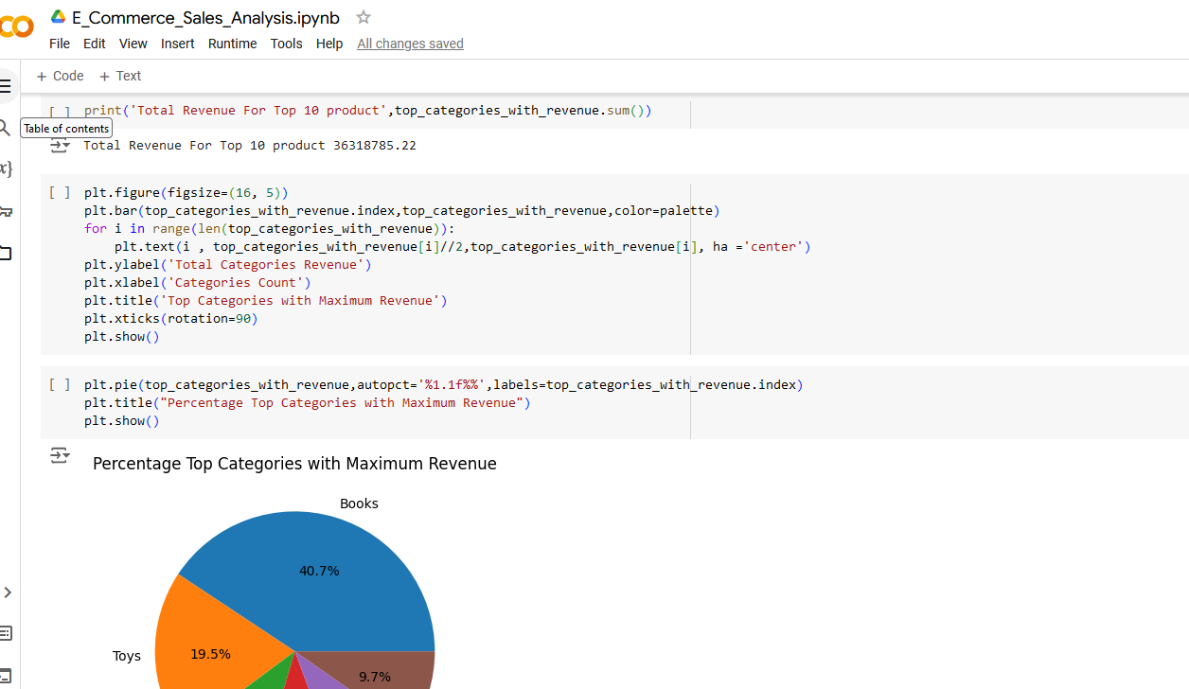
Video of Project Demo

Slide 9
Conclusion
In conclusion, this project provided valuable insights into e-commerce sales trends, helping to identify high-performing products, top revenue-generating categories, and seasonal sales patterns. The analysis revealed that products like books and sports equipment are consistent revenue drivers, while categories such as kitchen appliances may benefit from targeted marketing or promotions. Seasonal trends showed peak sales in specific months, which can guide inventory and marketing strategies. By implementing the recommendations derived from these findings, the business can optimize product offerings, align promotional efforts with customer demand, and improve overall profitability.

Slide 10
Future Scope
1. Implement machine learning models to predict future sales trends and product demand.
2.Integrate customer segmentation for personalized marketing and recommendations.
3.Add real-time analytics to track and optimize sales and inventory performance.
4.Use sentiment analysis on customer reviews to gain deeper insights into product satisfaction.
5. Expand analysis to include multi-channel sales data for a comprehensive sales performance overview.

Slide 11
Thank you!
Notes:
thank you very much for joining this PPT, keep learning.
11

